Slide 1



SUPPLY CHAIN MANAGEMENT DASHBOARD OF MAKEUP PRODUCTS
By Somya Agrawal
Let’s Move

Slide 2

INTRODUCTION
Supply chain management (SCM) encompasses the oversight and coordination of all activities involved in the flow of goods and services from the procurement of raw materials to the delivery of the finished product to the end customer.
Supply chain analytics is a valuable part of data-driven decision-making in various industries such as manufacturing, retail, healthcare and logistics.
The dataset used in this project is based on the supply chain of makeup products from a Fashion and Beauty startup.

Slide 3


INTRODUCTION
What is the current business challenge?
Supply chain faces inefficiencies in lead times, inconsistent supplier performance, high shipping costs and product quality defects.
Why it matters?
Supply chain inefficiencies directly affect customer satisfaction and profitability. Delay in product deliveries and rising costs from underperforming suppliers put pressure on profit margin and the ability to meet market demands on time.

Slide 4
OBJECTIVE AND DATASET CONTENTS
Objective
To analyze product performance and supply chain efficiency of different makeup products according to location, suppliers, customer demographics etc.
Features of Dataset
Product
Type
Stock
levels
SKU
Price
Availability
Location
Costs
Routes
Shipping
Costs
Supplier
Name
Production
Volume
Inspection Result
Defect
Rates
Shipping
carriers
Lead
Times
Shipping
Time
Order Quantities
Manufacturing Cost
Transportation modes
Revenue Generated
No. of Products Sold
Manufacturing Lead Time
Customer demographics

Slide 5
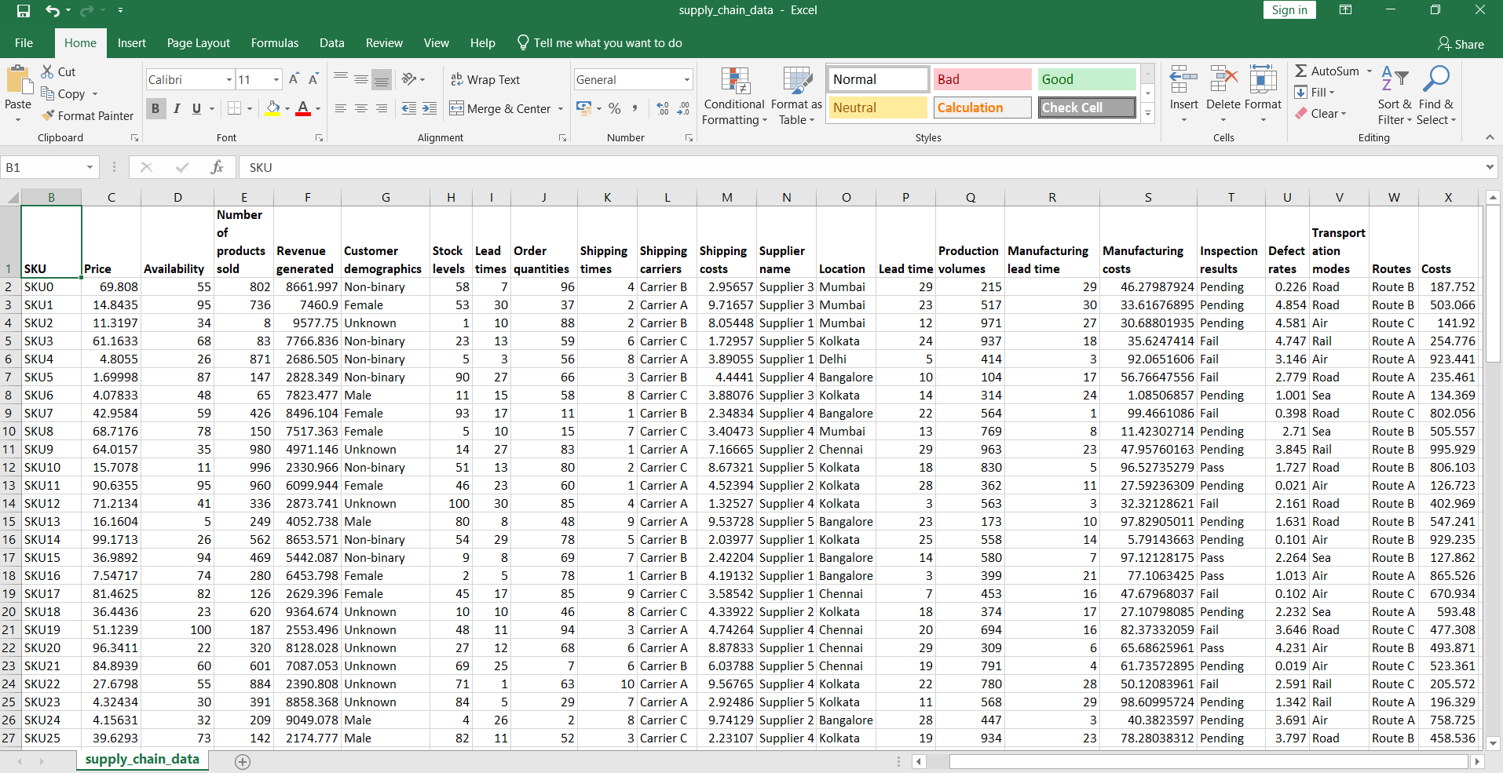
SUPPLY CHAIN DATASET

Slide 6

ANALYSIS QUESTIONS
Which Product Type generates the highest revenue?
Are there any significant correlation between Lead times and Order quantities?
How do shipping costs vary by Shipping carrier and Location?
Which suppliers have the most efficient manufacturing processes based on Manufacturing Lead time and Production volume?
What demographic group contributes the most to sales?

Slide 7
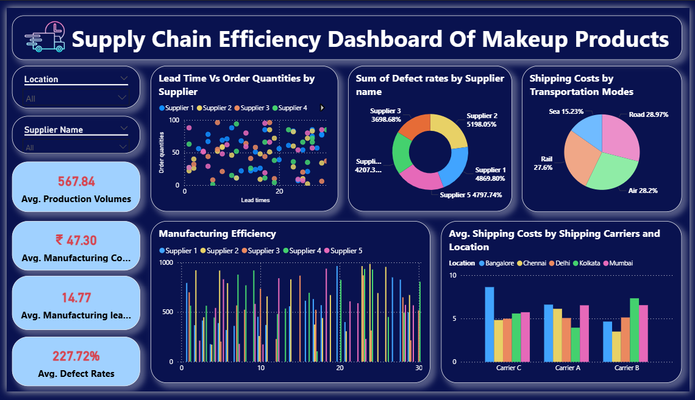

Slide 8
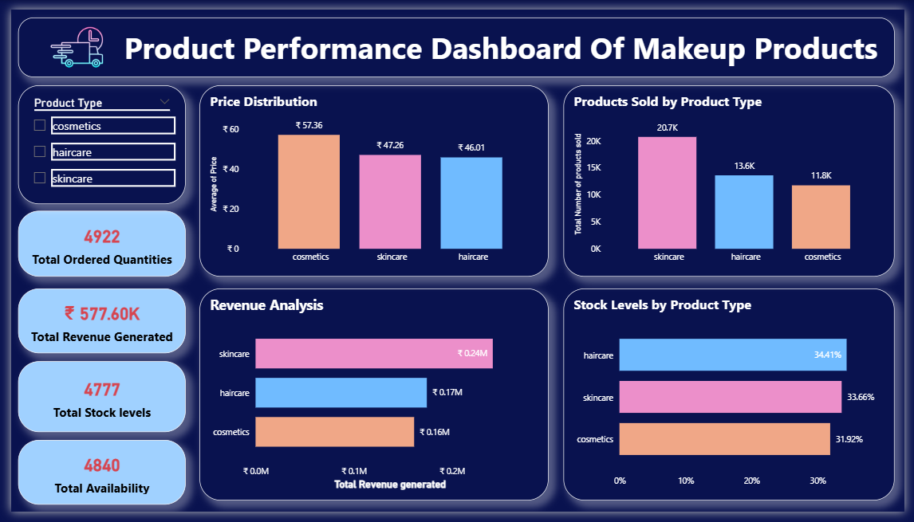

Slide 9
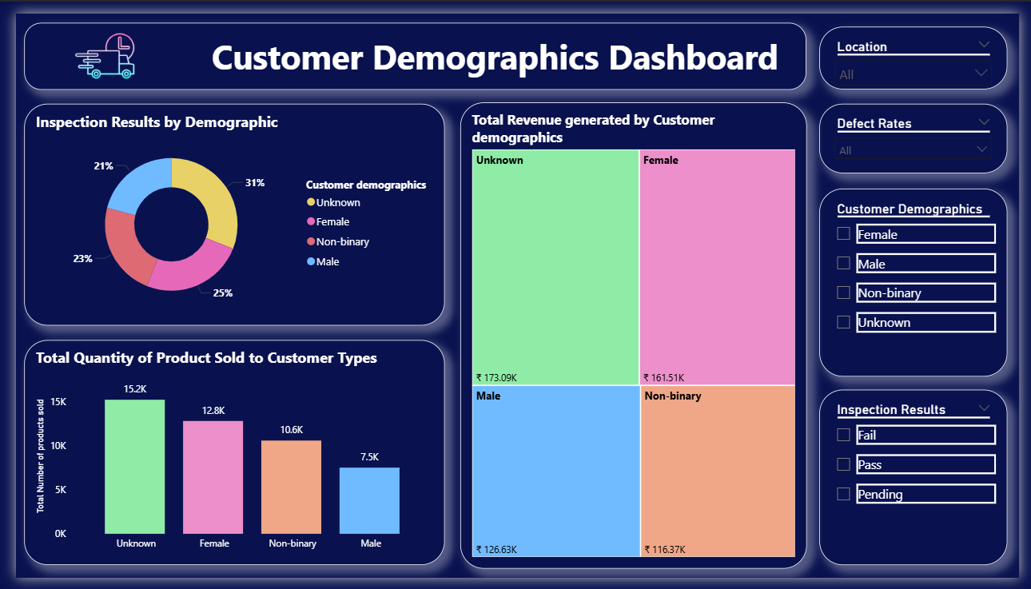

Slide 10
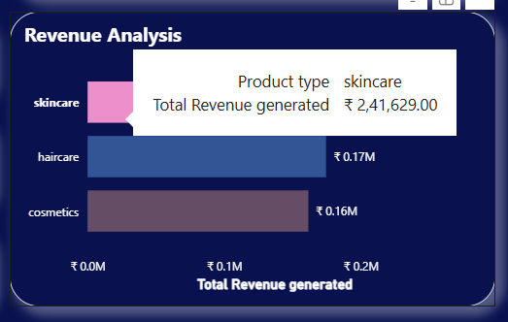
KEY INSIGHTS
Product Performance Dashboard - Revenue Insights
Skincare generates the highest revenue, amounting to INR 2,41,629 which makes up the largest share among all product categories.
High Revenue from skincare products suggests strong demand and could indicate a profitable area for strategic focus or marketing efforts.

Slide 11
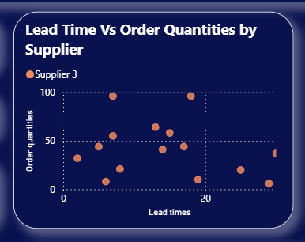
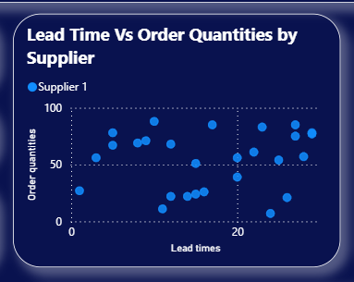
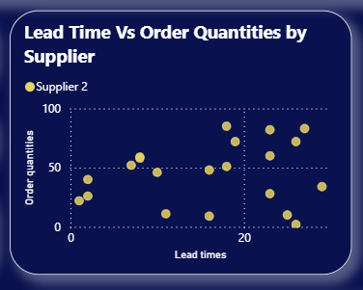
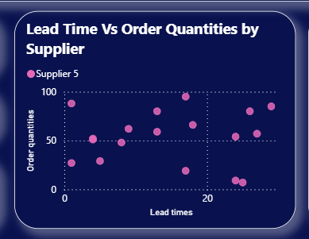
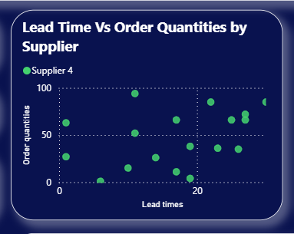
KEY INSIGHTS
Supply Chain Efficiency Dashboard - Lead Times and Order Quantities
There is a clear positive correlation between Lead Times and Order Quantities for Suppliers 1, 2, 4, and 5, indicating that as order quantities increase, lead times also tend to rise. Supplier 3, however, is an exception, showing no clear pattern or correlation between lead times and order quantities.

Slide 12
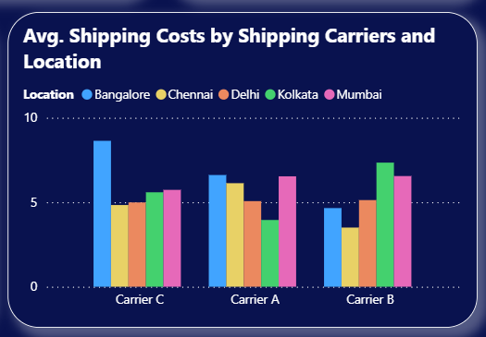
KEY INSIGHTS
Supply Chain Efficiency Dashboard - Shipping Cost Analysis
Carrier C consistently has the lowest shipping costs across all locations except Bangalore.
Carrier A shows moderate costs, with higher expenses in Mumbai and Bangalore.
Carrier B has the highest average costs, especially in Kolkata and Mumbai.
If your goal is minimizing shipping expenses, Carrier C might be ideal for cities other than Bangalore, whereas Carrier B could be smart for Bangalore specifically.

Slide 13
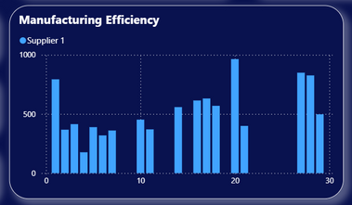
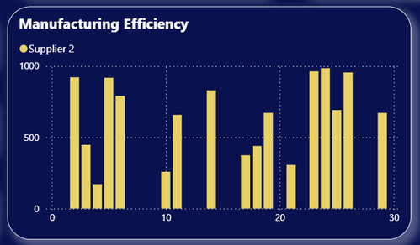
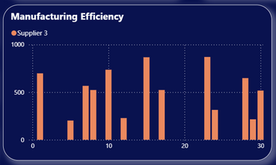
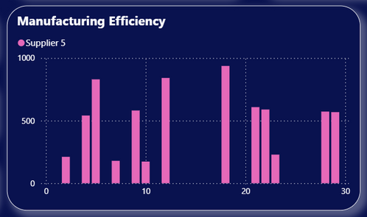
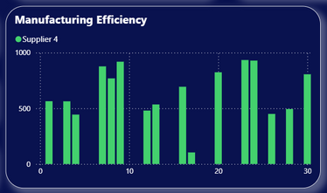
KEY INSIGHTS
Supply Chain Efficiency Dashboard - Manufacturing Efficiency
The most efficient supplier is Supplier 2 and the least efficient is Supplier 5.
Supplier 2 is the most efficient because it consistently delivers high production volumes, frequently reaching close to 1000 units, while maintaining a relatively low lead time.
Conversely, Supplier 5 is the least efficient as it has several periods with very low production volumes and widely varying lead times, demonstrating inconsistency and lower output compared to the other suppliers.

Slide 14
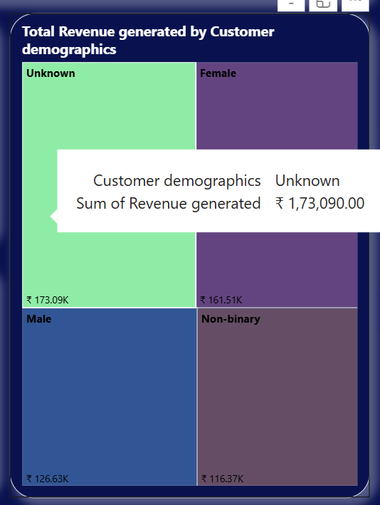
KEY INSIGHTS
Customer Demographic Dashboard - Revenue Insights
This treemap reveals that the highest revenue comes from customers with unknown demographics, totaling ₹1,73,090.
Female customers are the second-largest revenue source at ₹1,61,513, followed by male customers at ₹1,26,633.
Non-binary customers generated the least revenue, at ₹1,16,366.

Slide 15

SUGGESTIONS
Contact
Revise Marketing and Sales Strategies
Increase Production Efficiency
Switch to better data collection methods
Diversify carrier usage

Slide 16





HTTPS://NEON.ZAPFOLIO.IN/SOMYA_AGRAWAL936
SOMYA.AGRAWAL936@GMAIL.COM
HTTPS://WWW.LINKEDIN.COM/IN/SOMYA-AGRAWAL-ANALYST/
HTTPS://GITHUB.COM/SOMYA-AGRAWAL-9/

